Slide 1
Major Settlements

Slide 2
Social Studies vocab/Terms
8. Religion
9. Barter
10. Plaza
11. Council
12. Settlement
13.Conflict
14. Beringia Land Theory
15. Cherokee
16. Chickasaw
17. Creek
1. Agriculture
2. Civilization
3. Migration
4. Irrigation
5. Nomad
6. Ancient
7. Ceremony

Slide 3
Agriculture Farming or growing crops.
Civilization A group of people living together who have systems of government, religion, and culture.
Migration A movement from one region to another.

Slide 4
Irrigation A way of supplying water to crops with streams, ditches, or pipes.
Nomad A person who does not live in one place but moves around.
Ancient A long time ago.

Slide 5
Ceremony A formal event at which people gather to express important beliefs.
Religion The belief in one or more gods.
Barter To exchange goods without using money.

Slide 6
Plaza An open area near the center of a settlement.
Council A group of people who come together to make laws.
Conflict A disagreement.

Slide 7
Essay Starter
The four major indigenous settlements in Tennessee were the _____________ _____________ ____________, and ____________ periods. These periods had very distinct cultures and legacies.

Slide 8
Four Major Groups
Paleo-Indians
Archaic Indians
Woodland Indians
Mississippian Indians

Slide 9
Coats-Hines Site
Pinson Mounds
Old Stone
Chucalissa Indian Village

Slide 10
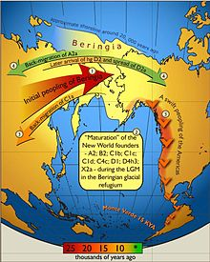
Land Bridge Theory

Slide 11
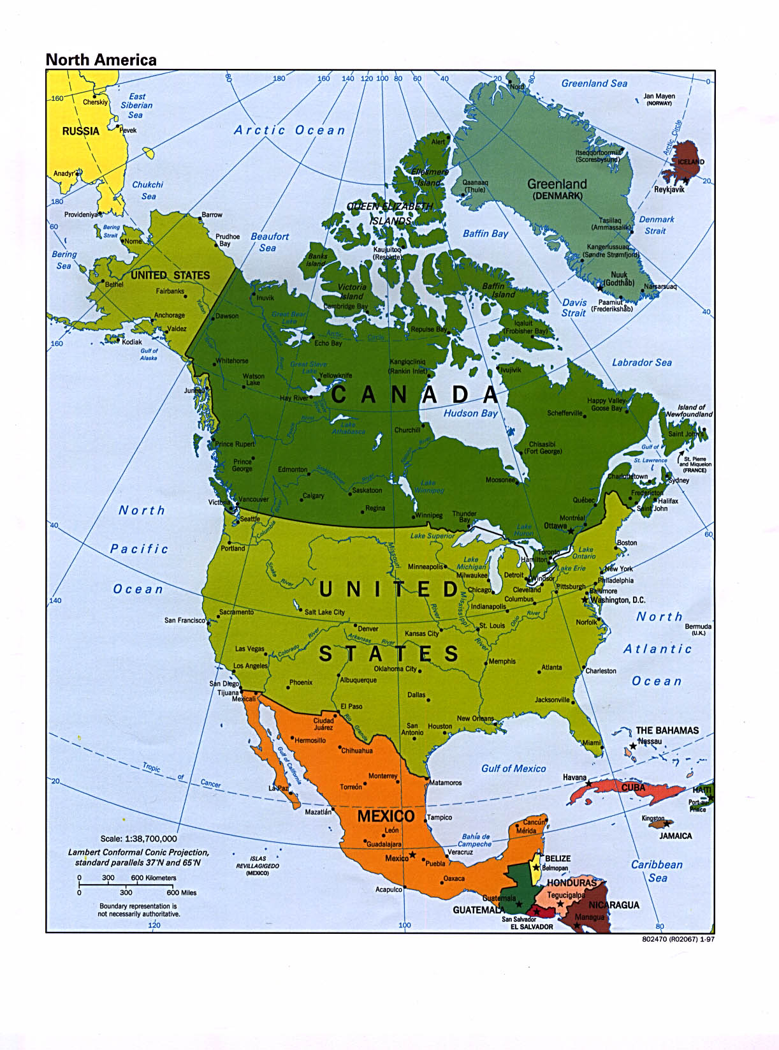
Beringia Land Bridge

Slide 12
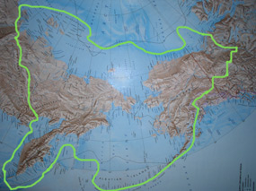

Slide 13
Major Civilizations in North and South America
Olmec’s
Aztecs
Maya
Mound Builders

Slide 14
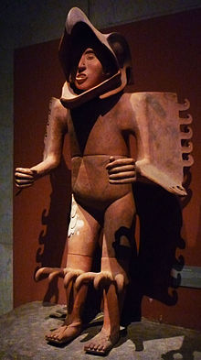
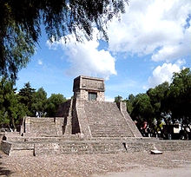
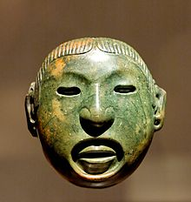
Aztec’s

Slide 15
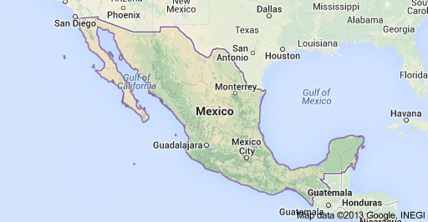
Mexico

Slide 16
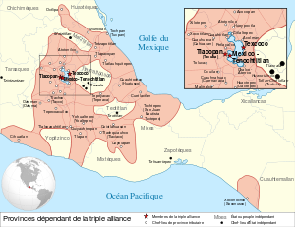
Empire

Slide 17
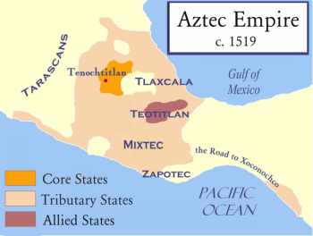

Slide 18
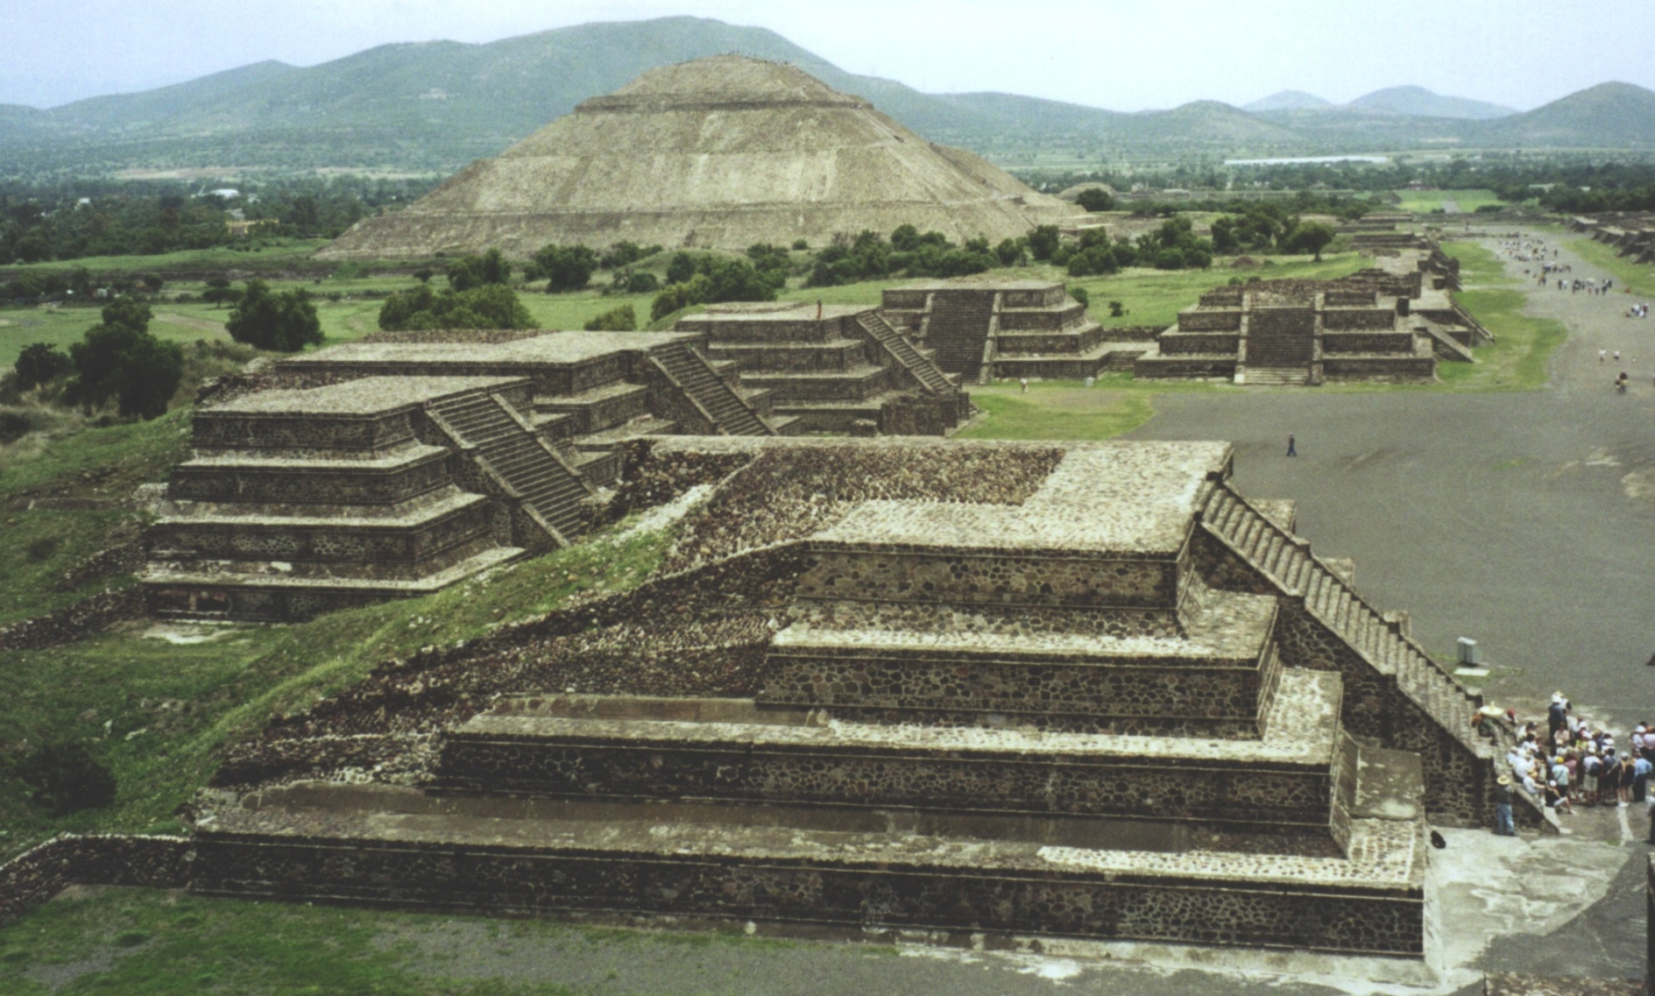
Aztec=Flat top pyramids

Slide 19
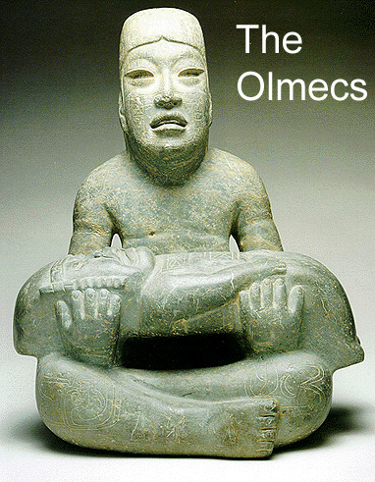
The Olmecs

Slide 20
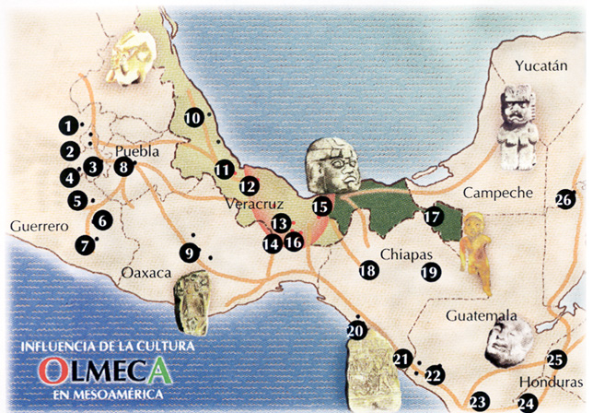
Location

Slide 21
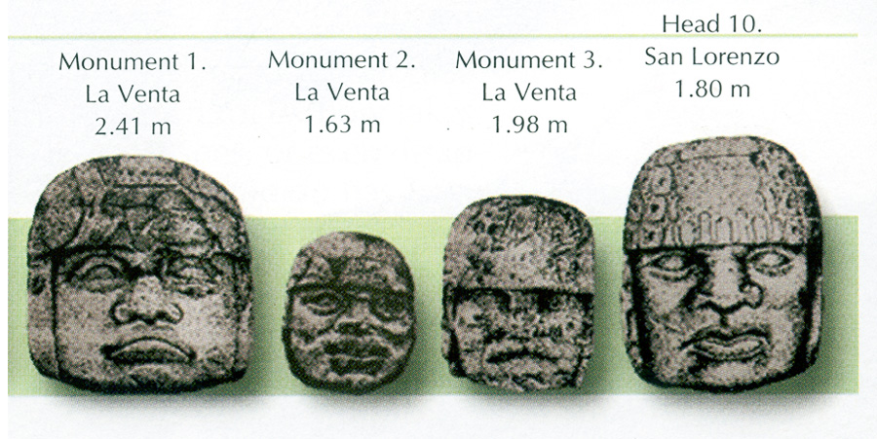
Big Heads

Slide 22
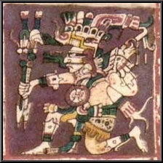
The Maya

Slide 23
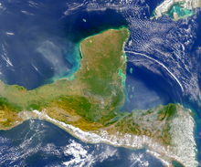
Yucatan Peninsula

Slide 24
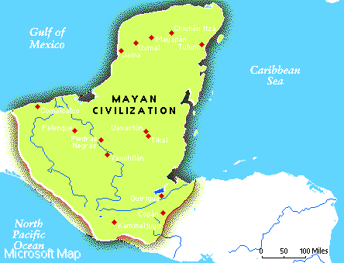

Slide 25
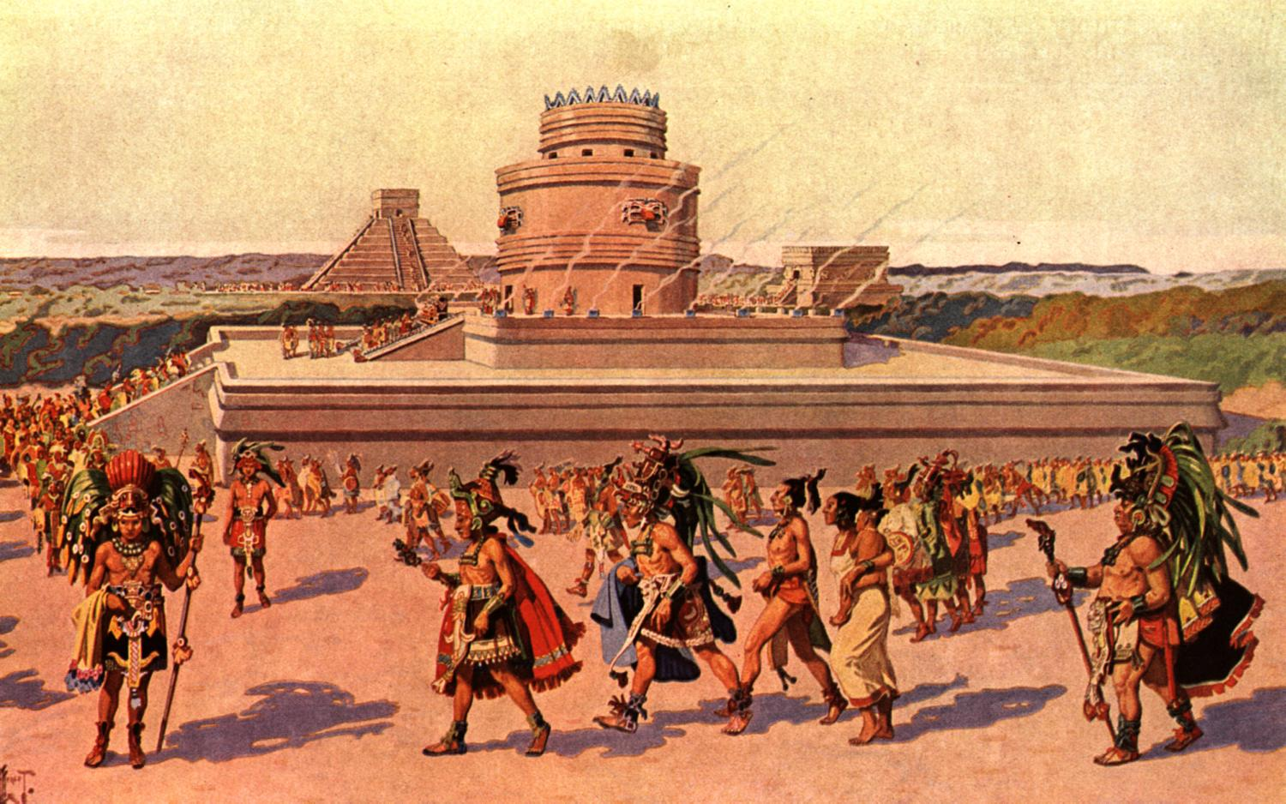
Mayan People

Slide 26
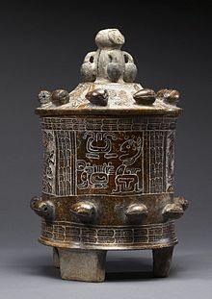
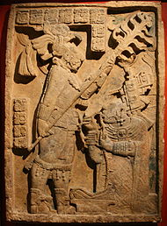
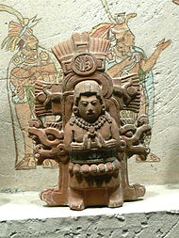
Artifacts

Slide 27
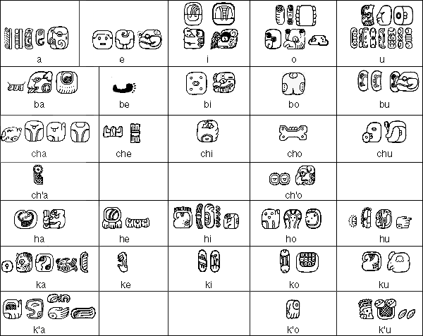
Advanced Writing

Slide 28
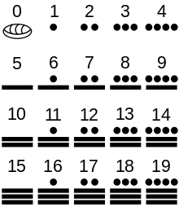
Number System

Slide 29
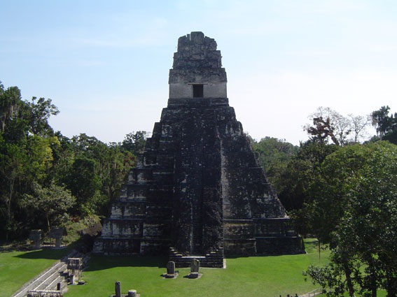
Tikal

Slide 30
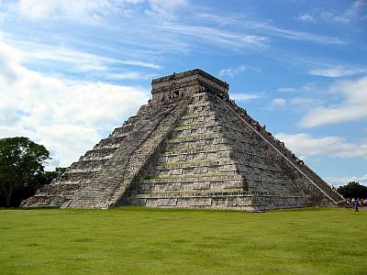
Chichen Itza

Slide 32
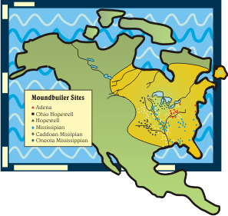
Mound Builders

Slide 33
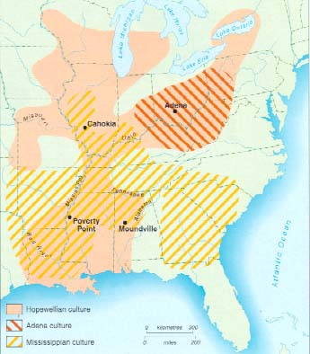

Slide 34
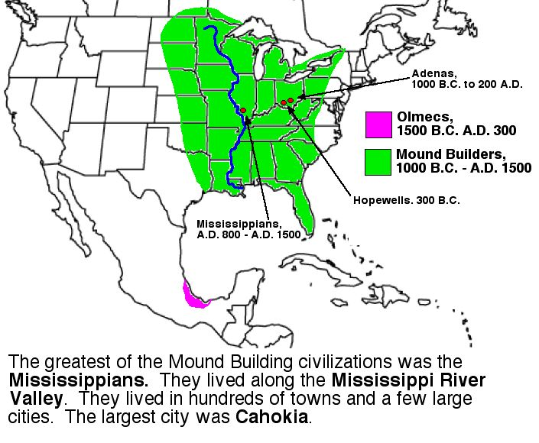
Mississippi River

Slide 36
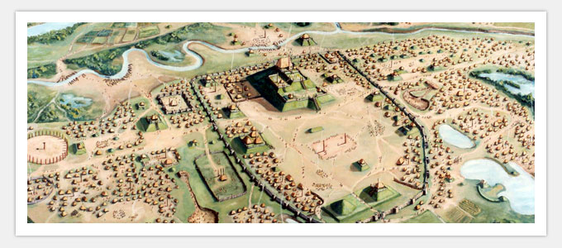

Slide 37
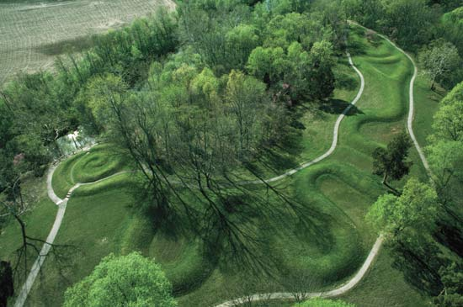

Slide 38
